Slide 1
A Distributed Virtual Time System for Embedded Linux Devices
Yuan-An (Brian) Liu
Christopher Hannon

Slide 2
Outline
Introduction
Architecture
Method
Result
Future Work

Slide 3
Introduction
Pausing and resuming any specified processes in the perception of their own virtual clocks
Utilize hardware interrupts to communicate between Linux devices for rapid synchronization of the distributed virtual time system.
Notes:
This work focuses on creating a hybrid testing platform simulation with Linux network devices such as HS. This system supports a distributed communication network using real networking hardware to analysis of communication network applications and their. The challenge in designing such a hybrid system is in the synchronization. We implement a solution for this synchronization challenge through a virtual time system.
An efficient system clock has to minimize the overhead of its own operation, ensuring the accuracy of the system. We demonstrate u

Slide 4
Introduction - Concept
Pi 1
Pi 2
VT Manager
Network Coordinator | Host Activities
Pause/Resume
VT Manager
Network Coordinator | Host Activities
Host 1
Host 2
Virtual Time Kernel
Virtual Time Kernel
Breadboard
Voltage Interrupt

Slide 5
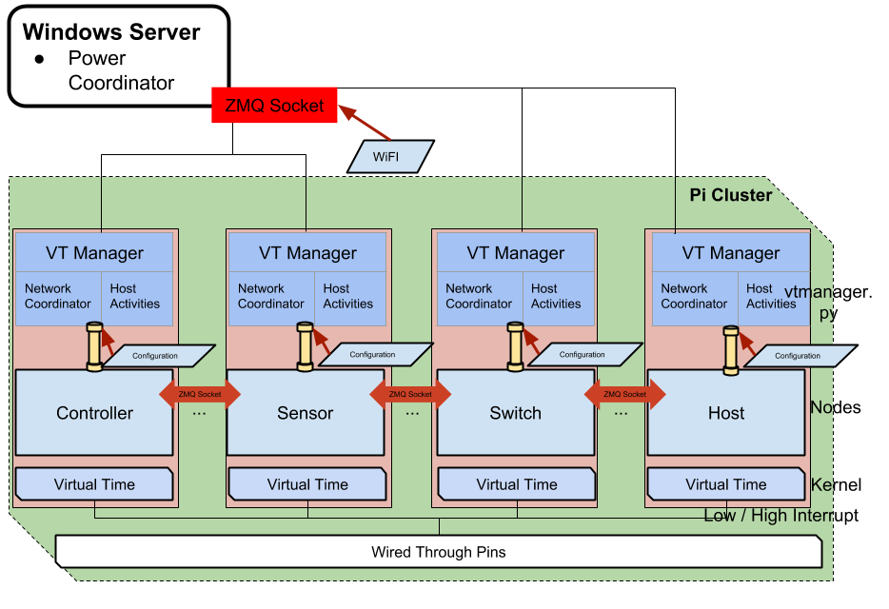
Architecture - The relationship between distributed systems.
Each node has 2 major layers: Virtual Time Manager and Virtual Time kernel.
They are all connected using Ethernet, wireless networking and direct hardware connection.

Slide 6
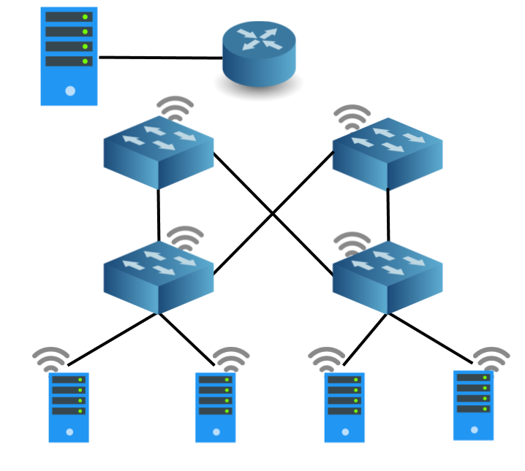
Architecture – distributed system
Architecture of distributed system composed of 3 communication channels: Ethernet, wireless management and direct hardware connection with general purpose and router Linux hardware.
Monitoring machine which is not in Virtual Time.
Embedded Linux devices
wireless and wired indicate the connection between switches, router and nodes
Notes:
OpenV Ryu R1

Slide 7

Architecture – System
Linux Debian 8 (Bananian 16.04)
Kernel 3.4.113+
OpenvSwitch 2.3.0
Python 2.7.9
GCC 4.9.2

Slide 8
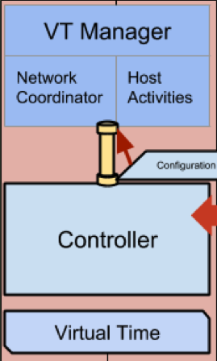
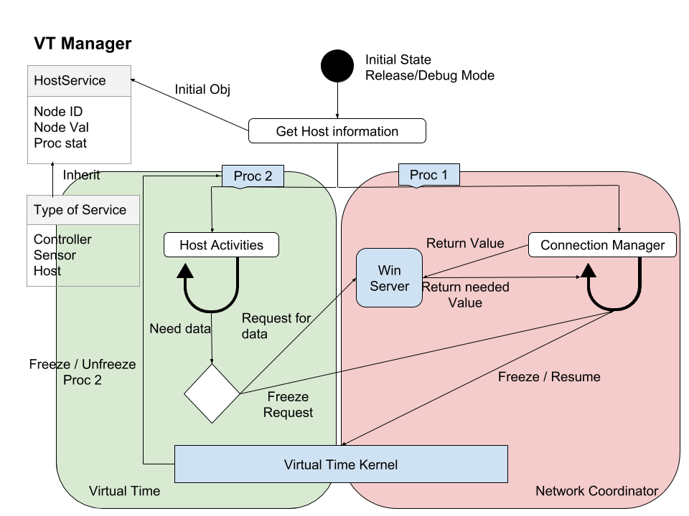
Method - Virtual Time Manager
The host activity. The host can be either a Controller, a Switch or a Sensor.
The Network Coordinator (NC) which handles all pausing, resuming and other network communications.
Notes:
Start at the same time using NTP

Slide 9
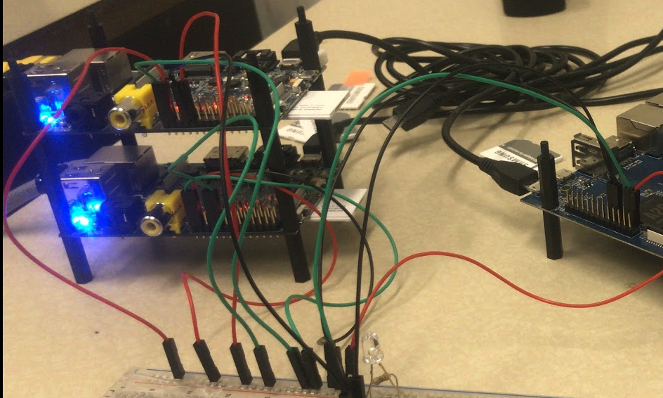
Method - VTGPIO
Notes:
2 Listen 1 increase and decrease

Slide 10
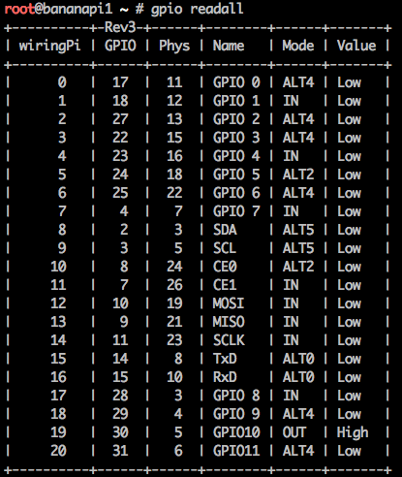
Method – VTGPIO

Slide 11
Result – Evaluation1
Host ---> NetCoor---> kernel ---> kernel ---> Host
∆T ∆T ∆T ∆T

Slide 12


Result – Evaluation2
VLAN
Open vSwitch
iPerf

Slide 13
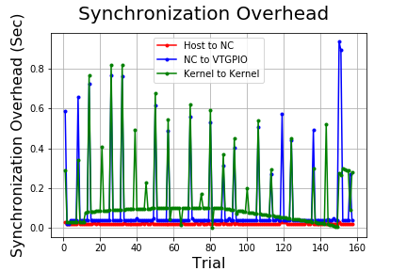
Result - Overhead

Slide 14
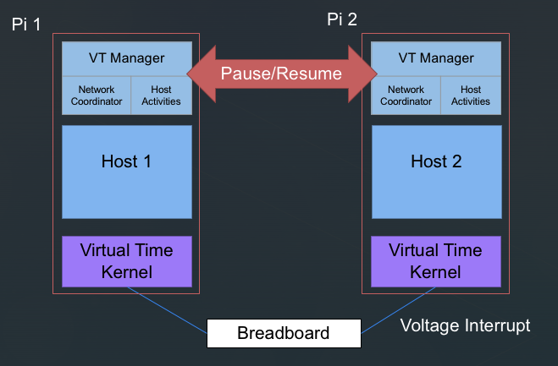
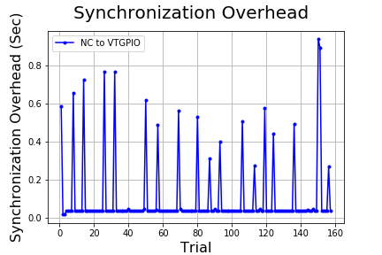
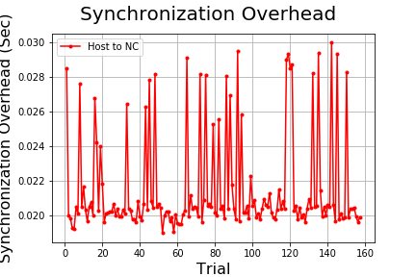
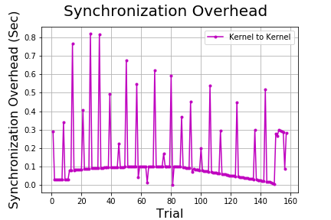
Result - Overhead

Slide 15
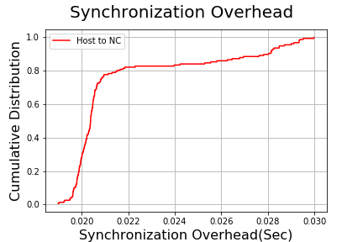
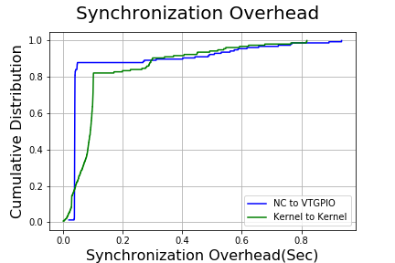
Result -CDF

Slide 16
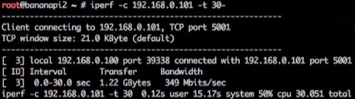
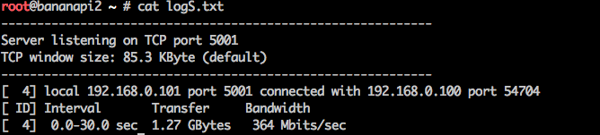
Result – iPerf Benchmarking
Notes:
limit num packet too low windows size.

Slide 17
Future Work
Win server
Simple Queue Structure
Add more nodes – increase the complexity
Increase accuracy
Improve evaluation
Notes:
1Win server
2Simple Queue Structure
3Add more nodes – increase the complexity
4Increase accuracy
5Improve evaluation

Slide 18
Questions?
Notes:
how large is the error and reason. tell that first. some else evaluation/

Slide 19
Reference
Christopher Hannon, Jiaqi Yan, Dong Jin: DSSnet: A Smart Grid Modeling Platform Combining Electrical Power Distribution System Simulation and Software Defined Networking Emulation
Christopher Hannon, Neil Getty: Heterogeneous Distributed Embedded Linux System for Hardware-in-the-Loop Smart Grid Testbed
Diego L. C. Dutra, Edilson C. Corrêa and Claudio L. Amorim: An efficient virtual system clock for the wireless raspberry pi computer platform

Slide 20
We will keep enlarging the structure!

